Slide 1
Orality and Bible Translation

Slide 2
Two Approaches to Orality and Scripture
Oral-Aural
Sociolinguistic
Focuses on orality inherent in the biblical text
A focus on the performative nature of oral traditions
Founded upon notion of an ‘oral’ Hebrew Bible
Focus on sound and performance
Audience focus
Limited literacy
Founded in anthropology, psychiatry, linguistics and philology
Focus on language and cognition
Vries, Laurens de. “Views of orality and the translation of the Bible.” In Orality and translation, edited by Paul F. Bandia. London: Routledge, Taylor & Francis Group, 2017.

Slide 3
Orality
Can mean different things to different people.

Slide 4
Orality and Scripture
Dynamic interface between oral and textuality
Rejection of the Great-Divide
Scribal culture
Scripture as aide-memoire
Performative Nature of Scripture
Oral Hermeneutics
Embodied Cognition
Relational
Phronesis
Perhaps there is a middle-way?

Slide 5
How does this impact translation/consulting?

Slide 6
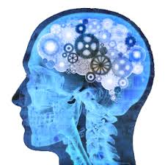
Cognition
Perceiving
Reasoning
Learning
Evaluating
Remembering

Slide 7

Cognition as
Computational Processing

Slide 8
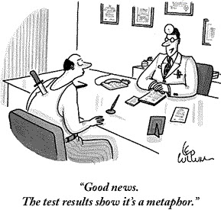
Oral Cognition
The world invades our neat computations
Educational philosophy has tended to interiorize cognition
Descartes’ Cogito - ”I think, therefore I am.”

Slide 9
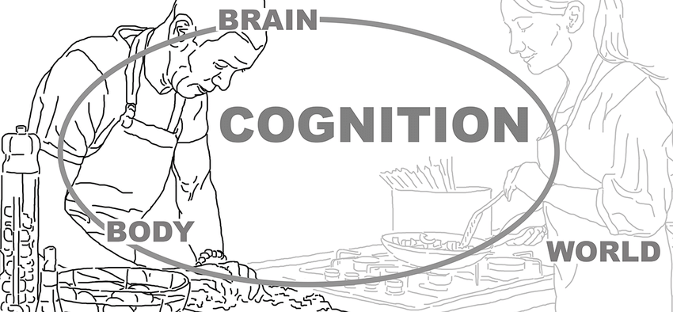
I am, therefore, I think

Slide 10
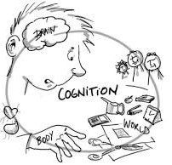
Embodied Cognition
grounded
Relates to the physical world.

Slide 11
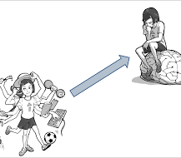
Embodied Cognition
embodied
Sensorimotor perception

Slide 12

Embodied Cognition
situated
Sociocultural context

Slide 13
How does this impact translation/consulting?

Slide 14
Orality and Phronesis

Slide 15
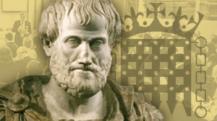
Phronesis – practical wisdom
‘…a state of grasping the truth, involving reason, concerned with action, about what is good or bad for a human being.’
-Aristotle

Slide 16
Oral epistemology
Embodied truth
Worldview-dependent
Honor-shame
Fear-Power
‘grasping truth’

Slide 17
Oral rationality
‘involving reason’
High context
narrative

Slide 18
‘concerned with action’
Oral praxis
‘Don’t tell me what to think, tell me what I should do’
From knowledge to wisdom

Slide 19
Oral ethics
‘about what is good or bad for a human being’
Focus on community and relationships
Proverbs, songs, parables

Slide 20
How does this impact translation/consulting?

Slide 21
Scripture Engagement
Oral Synthesis
Kelber, Werner H. The Oral and the Written Gospel : The Hermeneutics of Speaking and Writing in the Synoptic Tradition, Mark, Paul, and Q. Philadelphia: Fortress Press, 1983.

Slide 22
Fusion of Three Horizons
Bible
Audience
Author

Slide 23
Reading = Absent Author in an Oral World
Bible
Audience

Slide 24
Hearing = greater access, but still an absent Author in an Oral World
Bible
Audience

Slide 25
Bible
Audience
Author
Audience

Slide 26
How does this impact translation/consulting?

Slide 27
Further reading
Botha, Pieter J. J. Orality and Literacy in Early Christianity. Vol. 5. Eugene, Oregon: Cascade Books, 2012.
Carr, David McLain. Writing on the Tablet of the Heart: Origins of Scripture and Literature. Oxford ; New York: Oxford University Press, 2005.
Goody, Jack. The Interface Between the Written and the Oral. Cambridge: Cambridge University Press, 1987.
Horsley, Richard A., Jonathan A. Draper, John Miles Foley, and Werner H. Kelber. Performing the Gospel : Orality, Memory, and Mark. Minneapolis, MN: Fortress, 2006.
Kelber, Werner H. The Oral and the Written Gospel : The Hermeneutics of Speaking and Writing in the Synoptic Tradition, Mark, Paul, and Q. Philadelphia: Fortress Press, 1983.
Maxey, James A. From Orality to Orality: A New Paradigm for Contextual Translation of the Bible. Eugene, Or.: Cascade Books, 2009.
Ong, Walter J. Orality and Literacy : The Technologizing of the Word. 30th anniversary ed. London: Routledge, 2012.
Steffen, Tom, and William Bjoraker. RETURN OF ORAL HERMENEUTICS. [S.l.]: WIPF & STOCK PUB, 2020.
Vries, Laurens de. “Views of orality and the translation of the Bible.” In Orality and translation, edited by Paul F. Bandia. London: Routledge, Taylor & Francis Group, 2017.
Wendland, Ernst R. Orality and the Scriptures: Composition, Translation, and Transmission. Publications in Translation and Textlinguistics 6. Dallas, Texas: SIL International, 2013.

